Slide 1

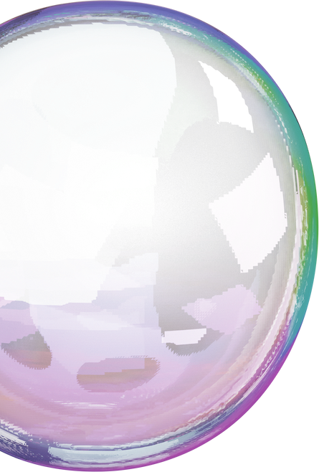
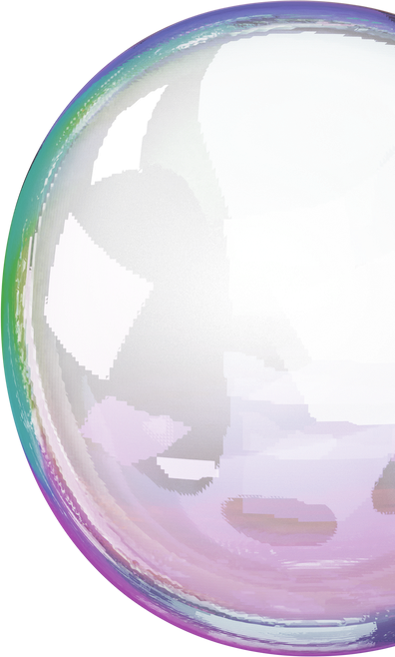

CLEARVISION AI
Submitted by:
Utsav Jain

Slide 2

Business Problem
Analytical Questions
Data set and Tools / Technologies
Process Flow
Pre-processing output
Implementation
Output Testing
Optimization
Scope Statement
Table of Content

Slide 3
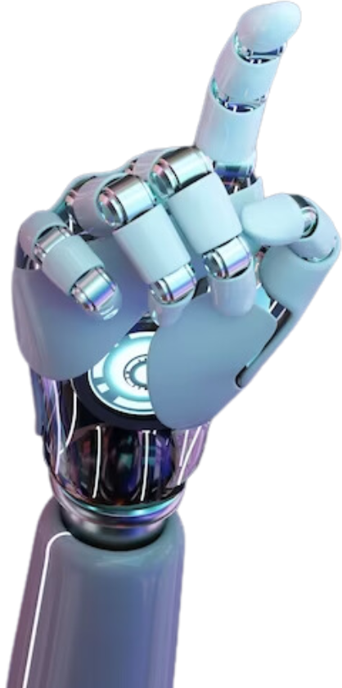
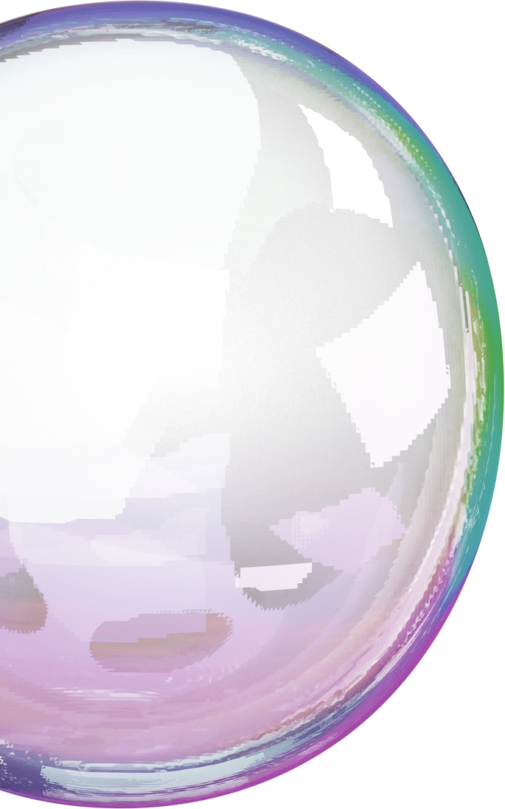

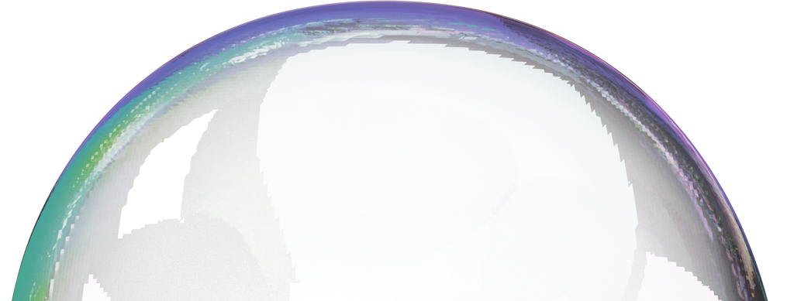
Business Problem
DeepFake technology is becoming more advanced and easier to use, making it a big problem for areas like banking and social media.
It allows people to create fake videos and images that can trick others, leading to financial scams and spreading false information. This makes it hard to tell what's real online, causing people to lose trust in what they see.

Slide 4
Analytical Questions
Q1: What datasets are available or have to be collected for preparing the deepfake model?
Decision: Decide the sources and quality of information required for demonstrating preparation and approval.
Q2: What features or characteristics separate deepfake recordings from bona fide recordings?
Decision: Recognize key highlights for demonstrate preparing (e.g., facial developments, audio-visual irregularities).
Q3: What are the framework prerequisites and framework required to convey the deepfake location demonstrate locally?
Decision: Arrange and apportion assets for framework sending.
Q4: How user-friendly is the framework for non-technical community individuals?
Decision: Make improvements to the client interface and client involvement based on input.

Slide 5
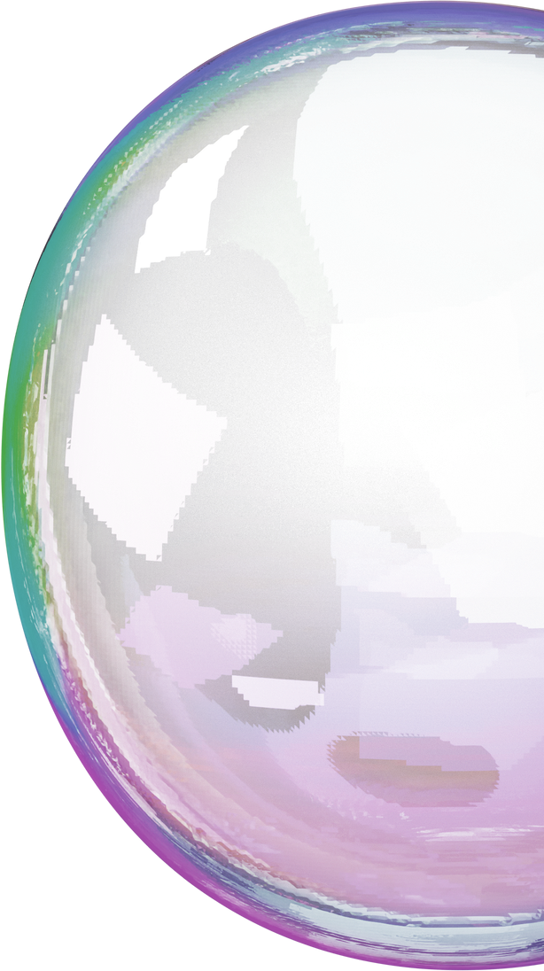
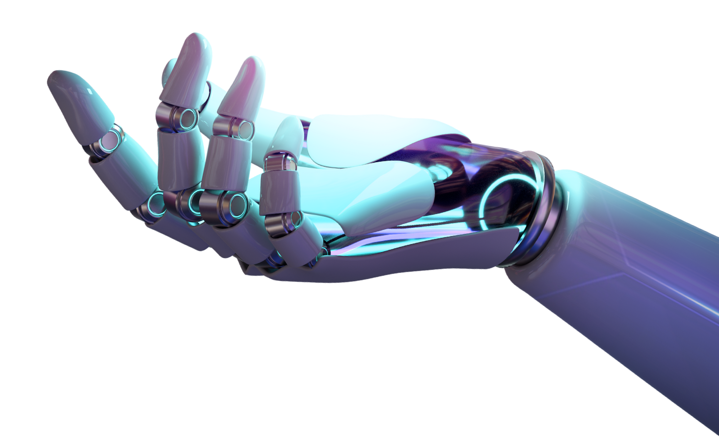

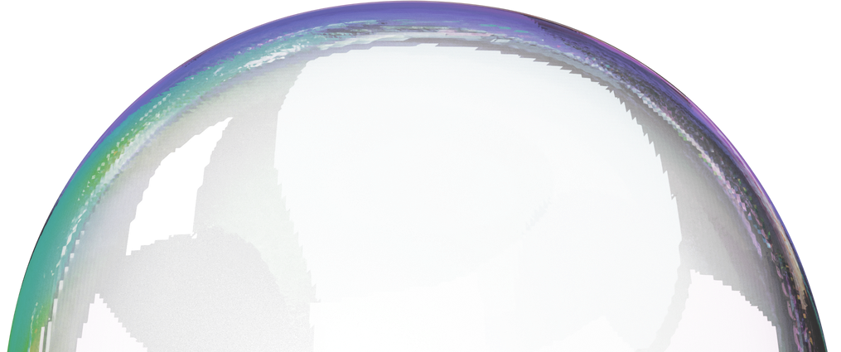
Scope
We are developing a user-friendly, web-based API for detecting manipulated images and videos.
The tool allows users to upload content for analysis, focusing on identifying deepfakes.

Slide 6
Training Data Collection: The project utilized videos from “Celeb DF” and “DFDC”, a platform recognized for its diverse video datasets, to evaluate and validate the deepfake face detection model’s training, accuracy and reliability.
Total Videos for Training: 1000+ videos
Data Set

Slide 7













Programming Languages
Python3
JavaScript
Programming Frameworks
Next JS
Fast API
Tools and Technologies
IDE
Google
Jupyter Notebook
Visual Studio Code
Workspace
Google Drive
GitHub

Slide 8
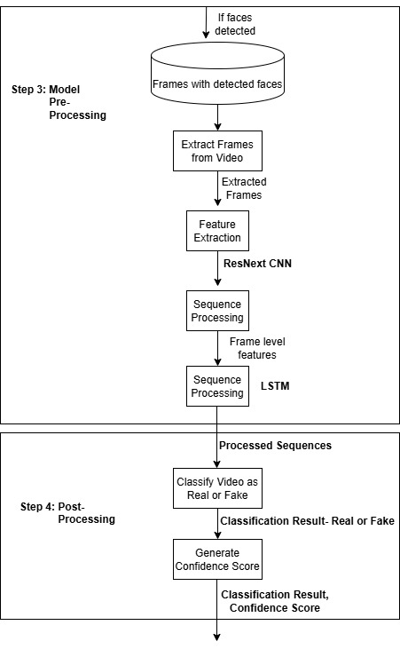
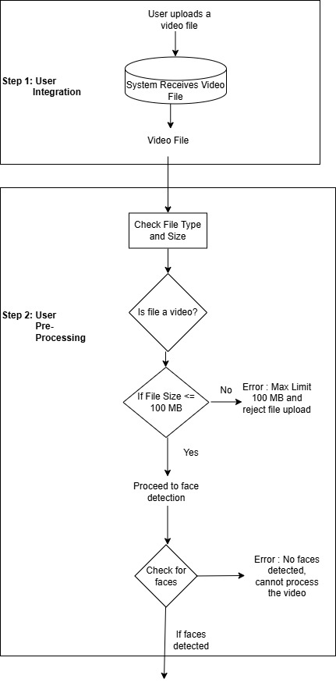
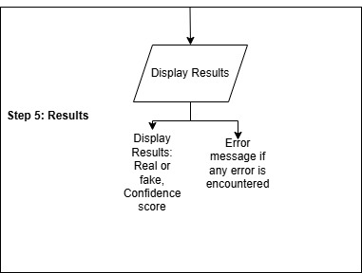
Process Flow Diagram

Slide 9
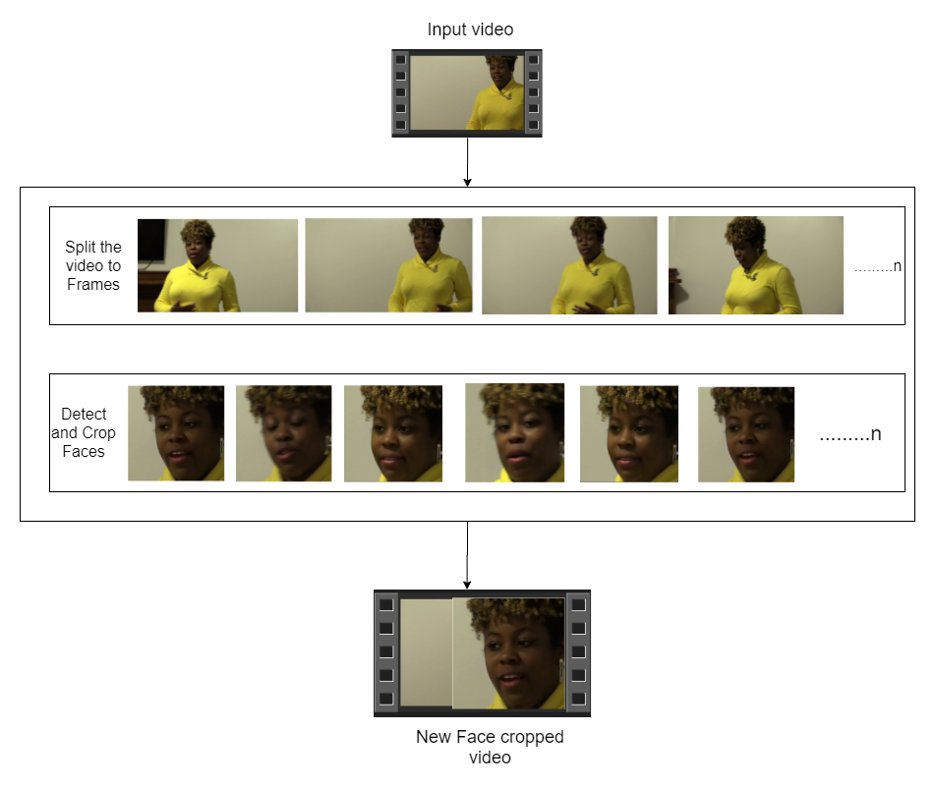

Pre-processing
1. Split Video into Frames
Extract individual frames from the video for processing.
Use DeepFace to identify faces in each frame.
4. Cropping Face
Crop the detected faces from each frame.
5. Creating New Face Cropped Video
Compile the cropped faces into a new video sequence.
5. Saving the Face Cropped Video
Save the new video containing only the cropped faces.
2. Pixel Normalization
Pixel normalization and resizing to 256x256.
3. Face Detection

Slide 10
Cropped Face Videos: Cropping and retaining only the faces from the original video for analysis.
Metadata: Data about videos, no of frames per face video and average of the entire video set
Status: Check for corrupted files and filter them out from the data set.
Pre-processing Output
This structured dataset, consisting of standardized cropped face videos, metadata, and optional annotations, serves as the foundation for deepfake detection research.

Slide 11
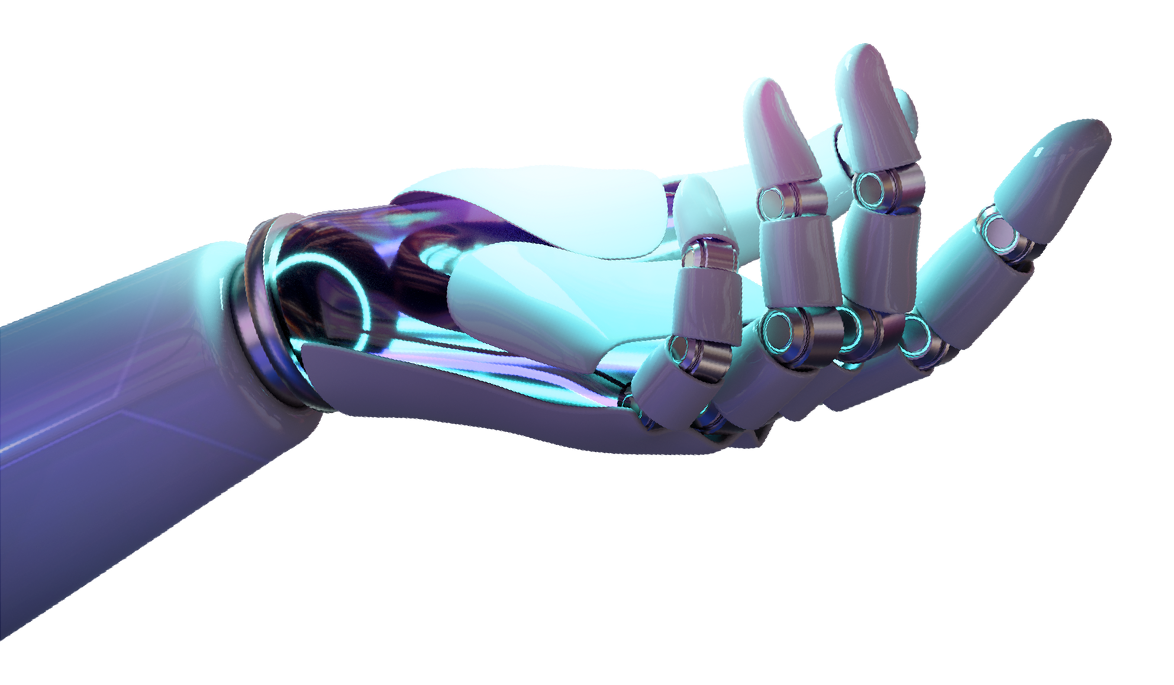

Train-Test Split: The dataset was divided into 80% training and 20% testing sets, both balanced between real and fake videos.
This setup ensured the model could effectively learn and accurately evaluate its ability to differentiate between genuine and manipulated content across various video types.
The model leverages a pre-trained ResNext CNN to extract features from video frames, which are then analyzed by an LSTM network to predict if the video is real or fake.
This sequential processing enables the model to detect subtle temporal changes, resulting in high prediction accuracy and confidence.
Model Training

Slide 12
Model Deployment: Real-time prediction capabilities.
Integration: Backend APIs for media processing.
Media Input: User uploads via frontend interface.
Model Inference: Authenticity determination.
Result Generation and Display: JSON results displayed to users.
Prediction

Slide 13
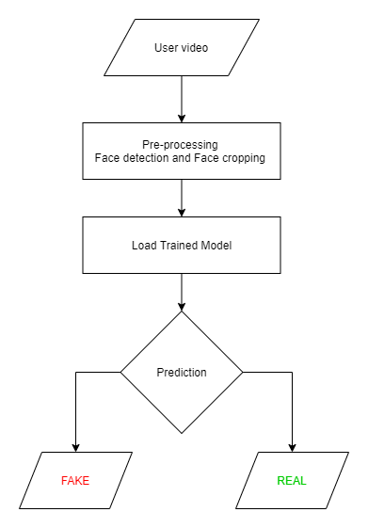
Prediction Workflow

Slide 14
Application Integration
1. Frontend Development:
User Interface: Built with Next.js, featuring a user-friendly interface for media uploads and result display.
User Interaction: Focused on smooth experience, reduced latency, and improved usability.
2. Backend Development:
POST Upload API: Manages media file uploads, validates formats, and oversees processing workflow.
3. Integration Models:
Web Integration: Enhances existing web infrastructures with minimal system modifications.
API Solution: Supports deep integration for embedding media verification into existing systems, offering scalability and security control.

Slide 15
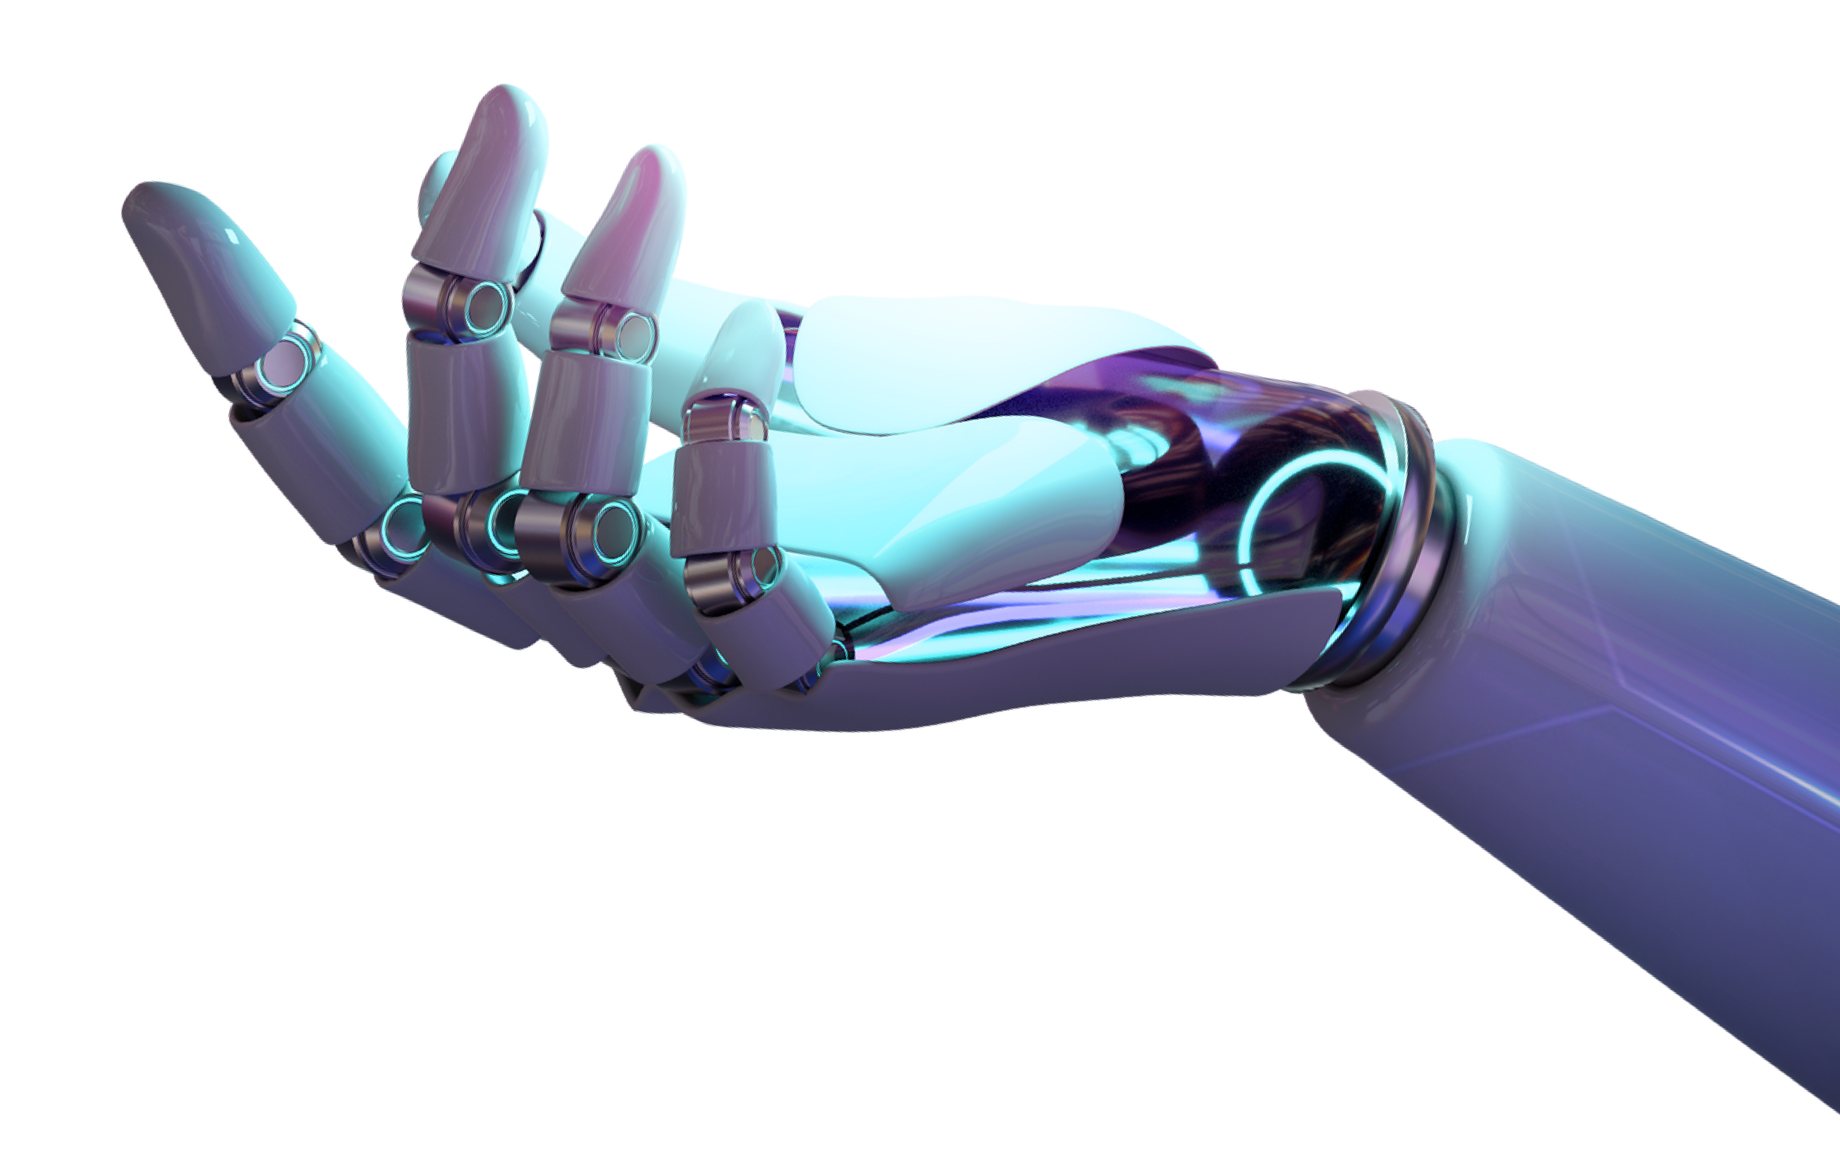

Optimization
Data Uploading with Sequence Length of 60
Streamline data handling by segmenting video data into fixed-length sequences for consistent processing.
Batch Processing
Concurrent Frame Analysis: Process multiple video frames simultaneously to accelerate analysis.
Efficiency Gains: Reduces computation time and speeds up overall video analysis workflow.
Scope: Handling Corrupted Videos
Automatic Detection and Deletion: Implement automated routines to identify and remove corrupted video files, ensuring data integrity and preventing processing errors.

Slide 16
Thank You!!

Slide 17
References
Fortune. (2019, June 12). Deepfake Video of Mark Zuckerberg Goes Viral on Eve of House A.I. Hearing. Retrieved from https://fortune.com/2019/06/12/deepfake-mark-zuckerberg/
The Guardian. (2019, June 22). The rise of the deepfake and the threat to democracy. Retrieved from https://www.theguardian.com/technology/ng-interactive/2019/jun/22/the-rise-ofthe-deepfake-and-the-threat-to-democracy
International Journal of Scientific Research and Development. (n.d.). Deepfake Video Detection using Neural Networks. Retrieved from http://www.ijsrd.com/articles/IJSRDV8I10860.pdf
Rossler, A., et al. (2019). "FaceForensics++: Learning to Detect Manipulated Facial Images." Proceedings of the IEEE/CVF Conference on Computer Vision and Pattern Recognition.

